Slide 1
Update
4DVD
Database
Python Package
By Riley Rutan

Slide 2
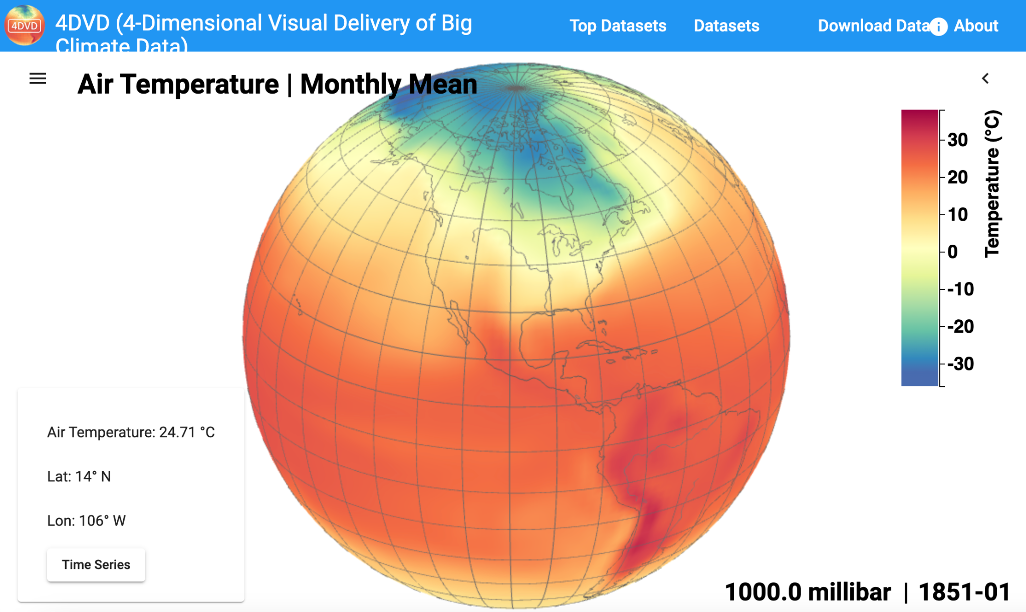
4DVD Background
https://4dvd.sdsu.edu/
“Everyone talks about global warming or climate change, but few have seen the climate data, because accessing climate data can be a technically challenging task. This 4-Dimensional Visual Delivery of Big Climate Data (4DVD) enables anyone to access climate data immediately as long as the person can navigate a website”
Web application built by Climate Informatics Laboratory at SDSU

Slide 3
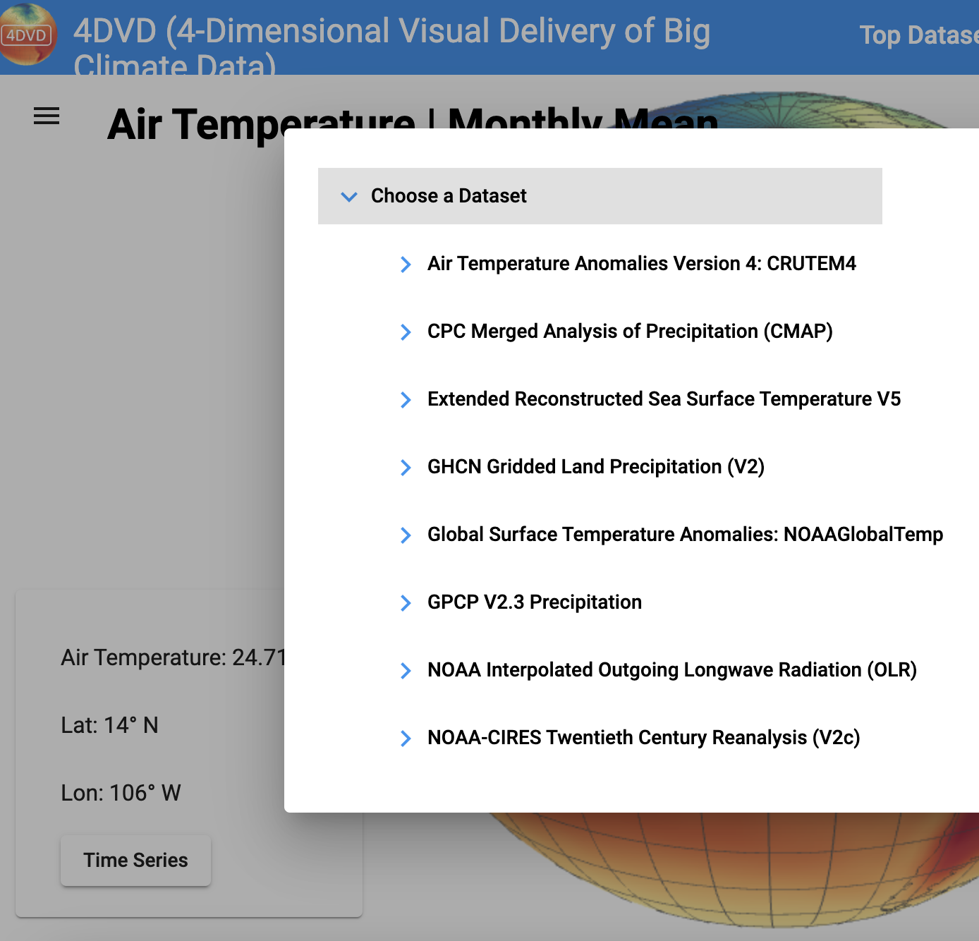
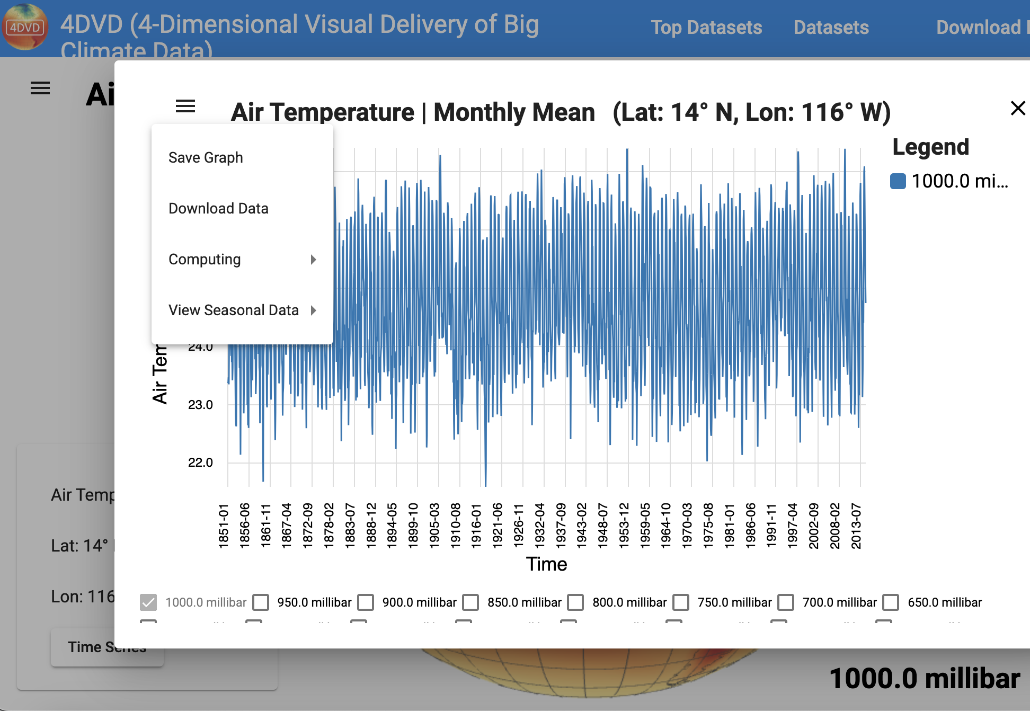
4DVD Key Features
Climate datasets are stored in relational database on SDSU servers for fast data delivery
Allows for time series analysis, statistical and climatology analysis, linear modeling and data downloading

Slide 4
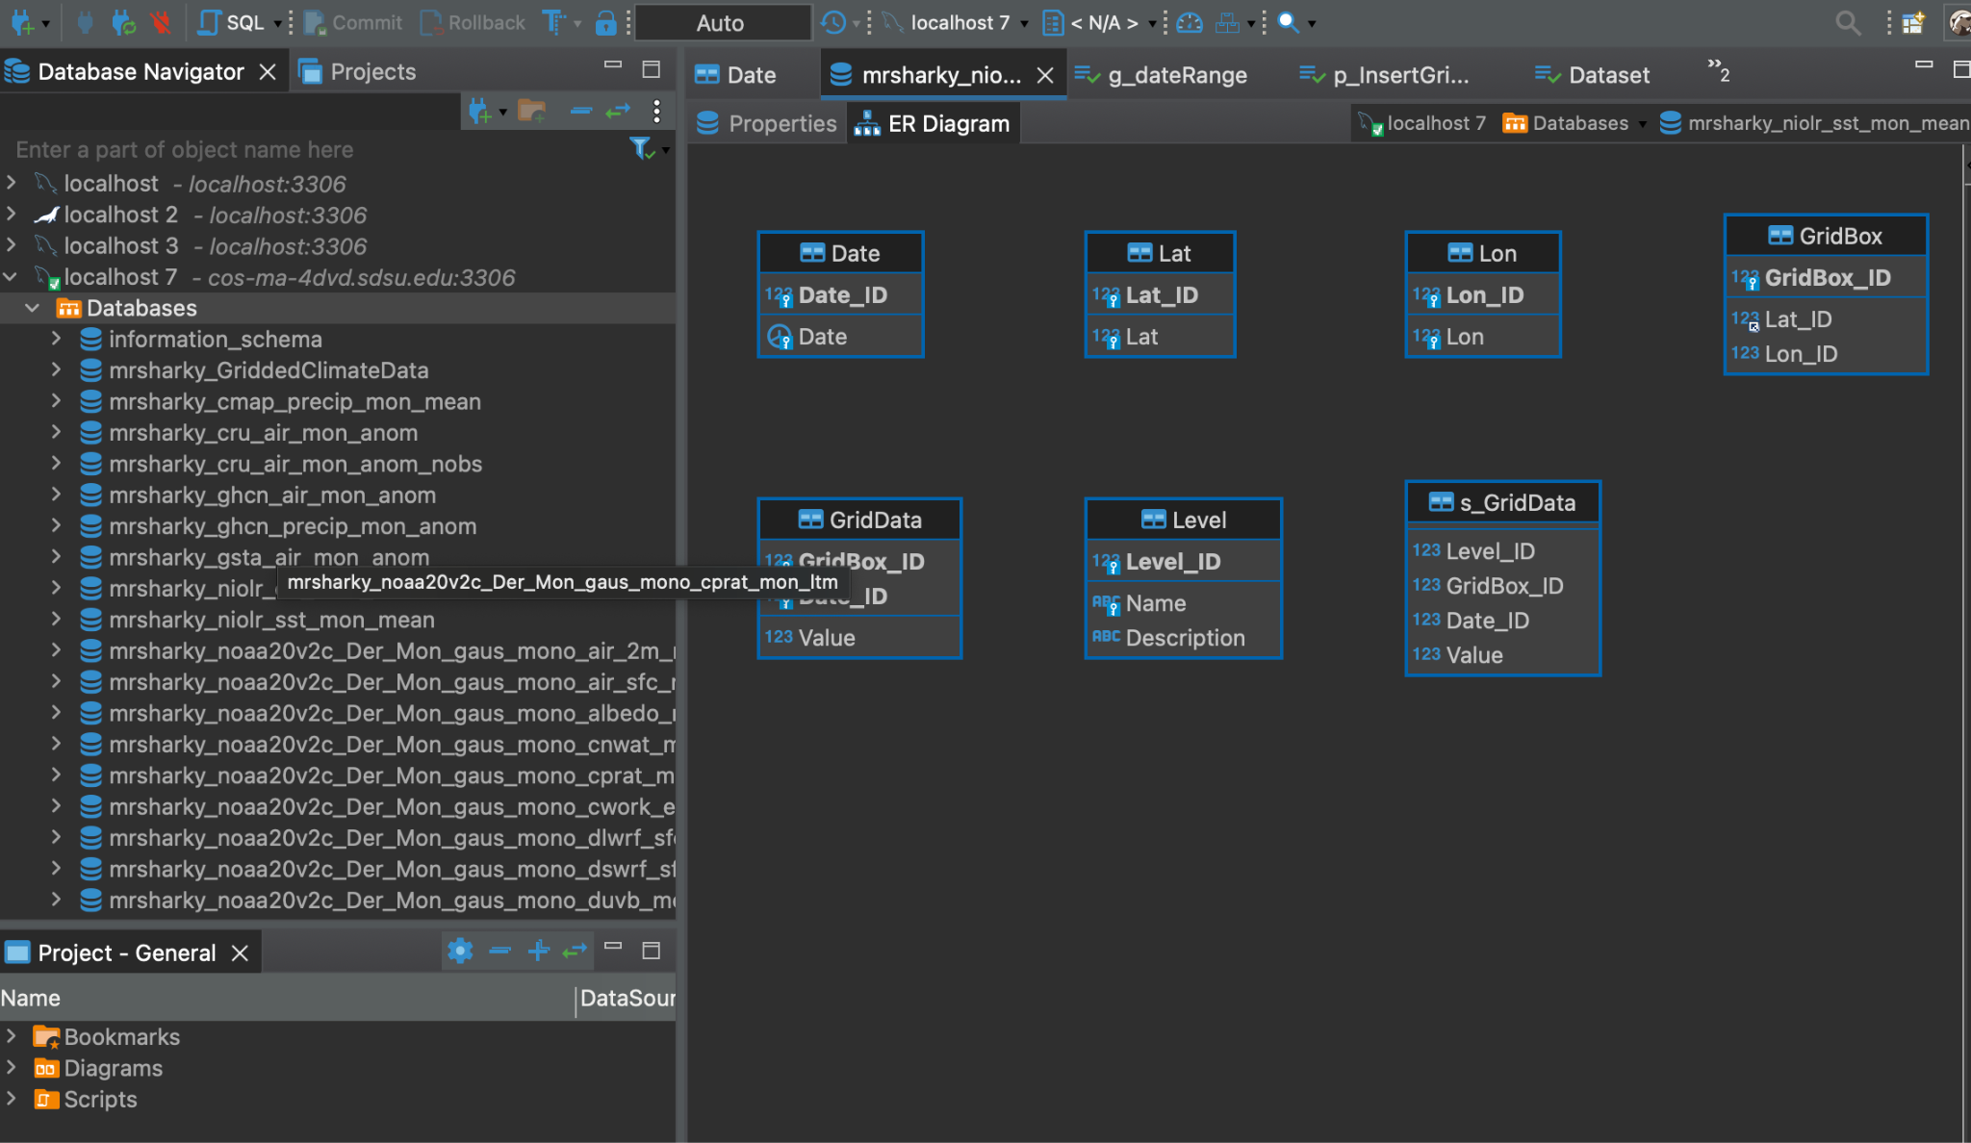
4DVD Database
Data is stored on a remote server
Data originates from NOAA in netCDF files but stored in tables in a SQL database
Allows for fast data delivery, but updating and inserting data is nontrivial

Slide 5
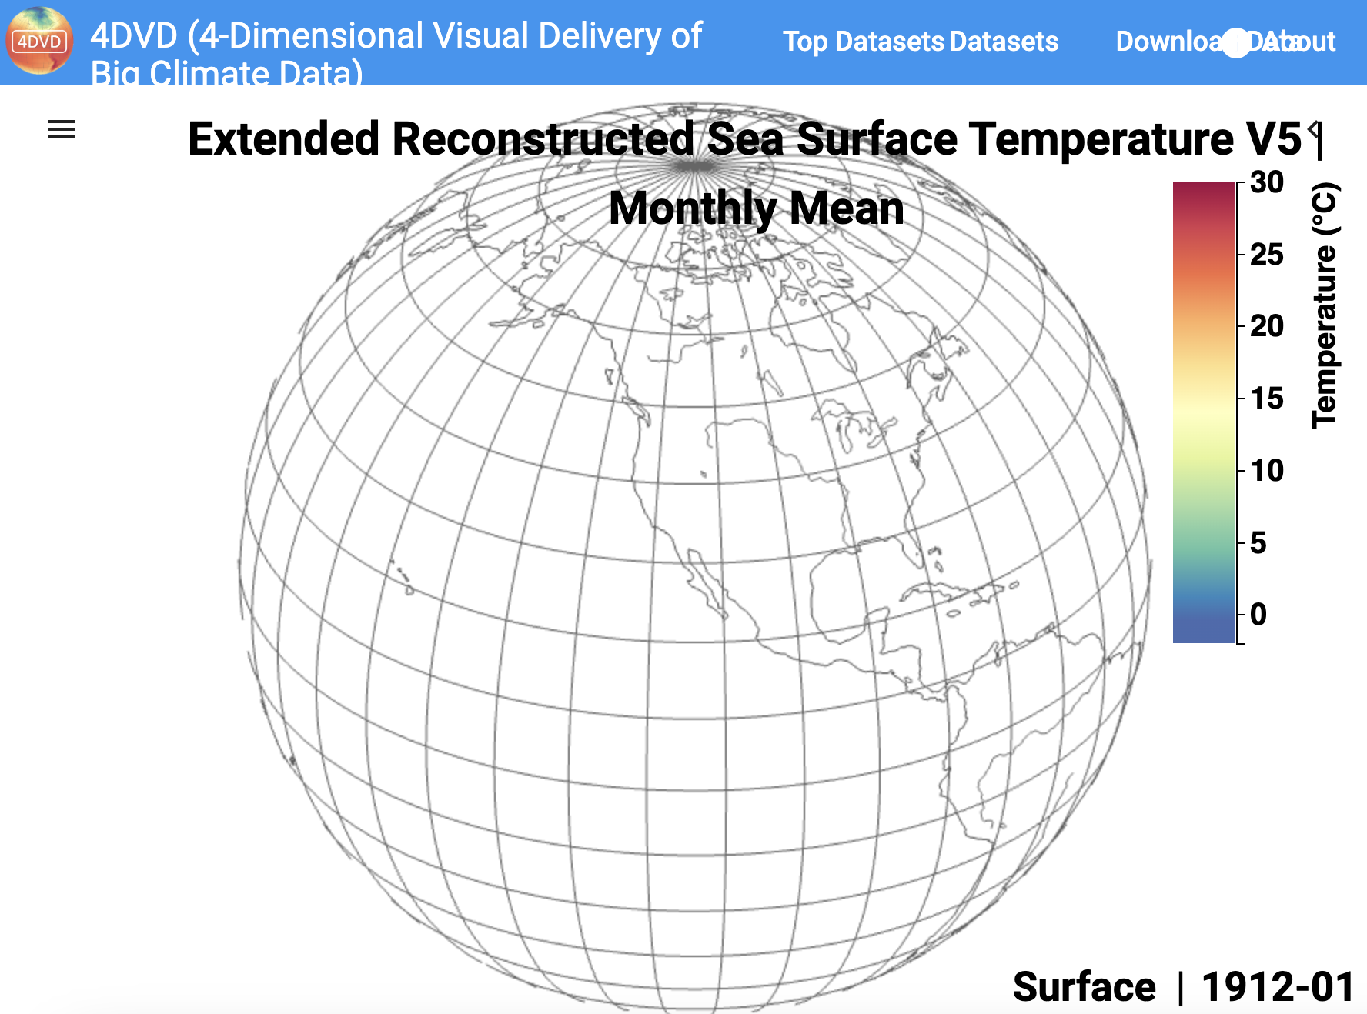
Problem Statement
Large chunks of missing data from the ERSST
dataset of 4DVD front end
This data is also missing from the database on the 4DVD server
Legacy software to update the 4DVD db is undocumented, outdated, and broken

Slide 6
Mission Statement:
Develop 4DVD Database Python Package
LOAD
TRANSFORM
INSERT
Retrieve gridded climate data from NOAA’s cloud storage of user’s local machine
Process data into a format that matches the structure of the database architecture
Insert the processed data into the MySQL database
With Python functions that are reusable, reable, and does not require the user to be familiar with vast amount of languages and technologies that run 4DVD

Slide 7
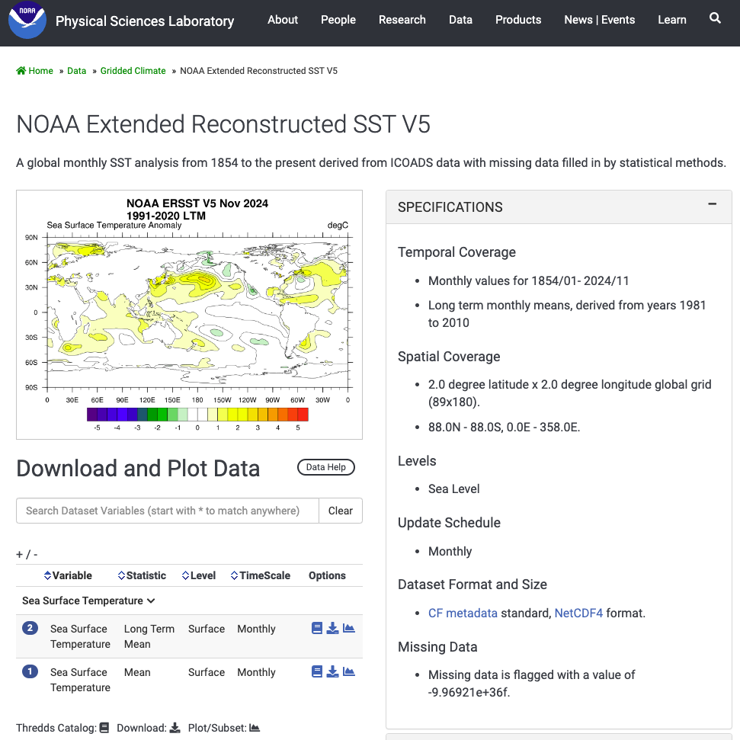
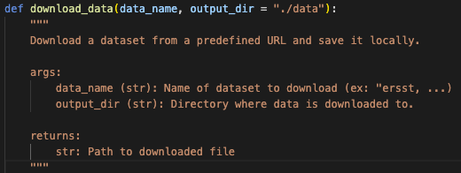
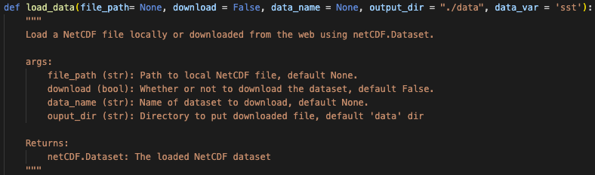
1. get_data.py
Utilizes Python Libraries xarray, os and requests
https://psl.noaa.gov/data/gridded/data.noaa.ersst.v5.html

Slide 8
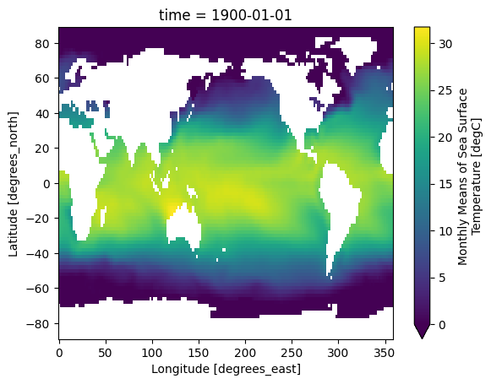
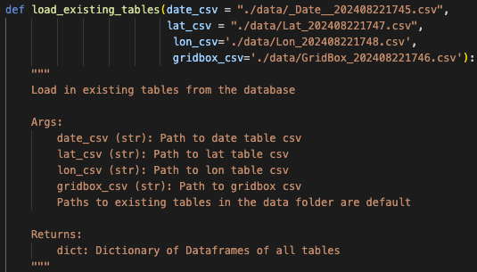
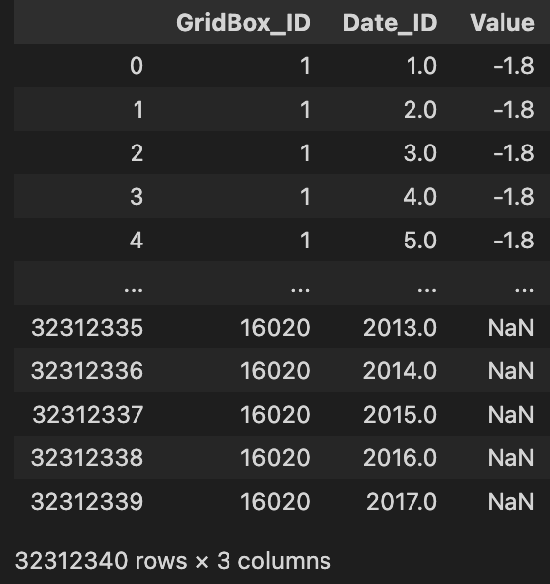
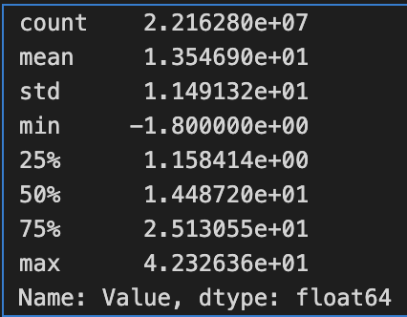
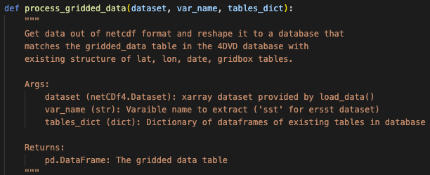
2. convert_data.py
Utilizes Python Library pandas

Slide 9
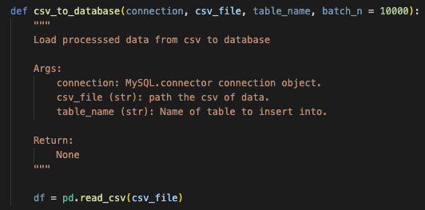
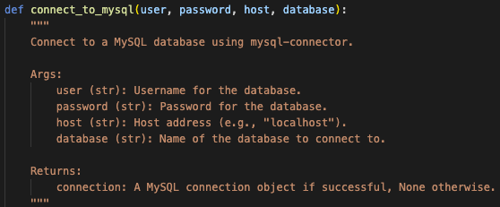
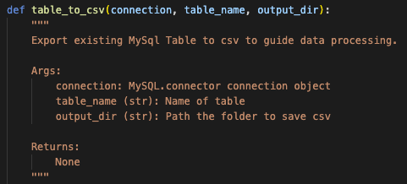
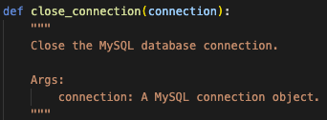
3. insert_data.py
Utilizes Python Library mysql.connector
the

Slide 10


4DVD
Database
Python pipelines to make climate data more equitable and easy to interact with.
load_data.py
insert_data.py
convert_data.py

Slide 11
THANKS!
Does anyone have any questions?
riley.rutan@gmail.com

